Slide 1
Digital Gaming
A Detailed Analysis by Kausik N

Slide 2
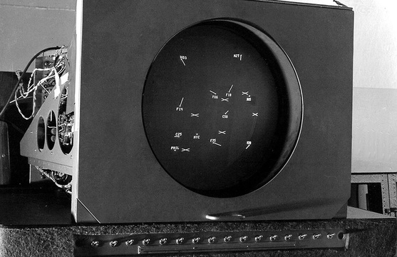
What is Digital Gaming?
Digital Gaming is the act of playing video/ digital games.
Digital Games are,
Interactive Software
Provide Entertainment
Maybe Casual, Serious or even Educational
First Game - (1947) It consisted of a analog device that allowed a user to control a vector drawn dot on screen to simulate a missile fired at targets.

Slide 3
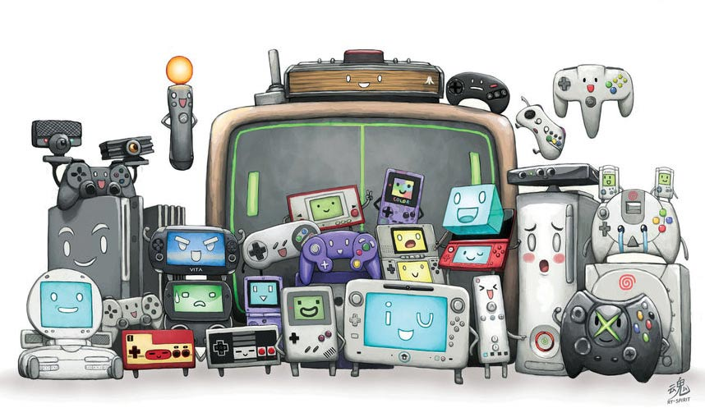
What are the gaming platforms?
Gaming platforms are computer systems made specifically for playing video games.
They are,
PC - Personal Computers
Console - Playstation, XBox, SNES
Handheld - PSP
Arcade - Arcade games
Web Browser - Web/Internet Games
Mobile - Mobile Games
Virtual Reality - VR Games (NEW)
Blockchain - Newest

Slide 4


What are the Development Tools available?
Early games were made using non GUI tools and directly using languages like C, C++, Java, etc.
Nowadays developers use Engines and GUI Tools to develop faster and better.
Tools are,
UnReal Engine
Unity
Godot Engine
GameMaker Studio
Other tools for making specific type of games exist like RPG Maker for making RPG Games.

Slide 5

What are the Benefits of Gaming?
Maybe Educational and help increase knowledge
Some Games bring awareness to important social or political issues (Dumb Ways to Die is a Mobile game created to bring awareness about safety near trains)
Puzzle Games help improve memory, problem solving skills, etc
Fitness Games provide extra motivation and tips to exercise and help us keep fit
Most important of all games provide entertainment and help us to relax from our stressful lives for some time

Slide 6

What are the Criticisms to Gaming?
Addiction to Gaming - we may get addicted to games thereby ignoring our real life duties
Concentration reduction in studies for children
It encourages children to stay at home instead of going out to play - increased risks of obesity, and other health issues
Some games may influence people’s or more importantly the minds of children in bad ways - Violence, etc

Slide 7
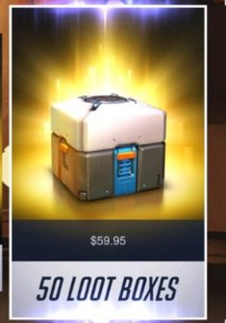
What is the Gaming Business?
The Gaming Industry is nowadays a highly profitable industry for both independent developers and Big companies due to various game distributors like Steam
As of May 2015 the gaming market stands at $74.2 Billion
North America - $23.6 Billion (Highest)
Asia is soon expected to cross North America as more and more free to play games come into the market
Games make money by,
Directly by purchase of the Game for paid games
Bonus content like DLCs and Expansion Packs or HD Releases or Remasters
For Free to play and online games through online transactions and microtransactions

Slide 8

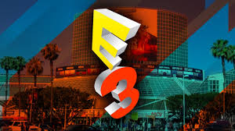
What are Conventions and ESports?
Conventions -
Annual GamesCom in Cologne in August (leading convention)
E3 in June in Los Angeles (global importance, but only for industry insiders)
Tokyo Game Show in September (main fair in Asia)
Other specific conventions are BlizzCon (Blizzard), MineCon (Minecraft by Mojang Studios), QuakeCon (Quake by ZeniMax Media), X Con (Xbox by Microsoft), NVision (NVidia)
Esports - Video Game competitions played by professional gamers worldwide
Common genres are fighting, first-person shooter (FPS), multiplayer online battle arena (MOBA) and real-time strategy
Major League Gaming (MLG) is a company that reports tournaments that are held across the country.

Slide 9
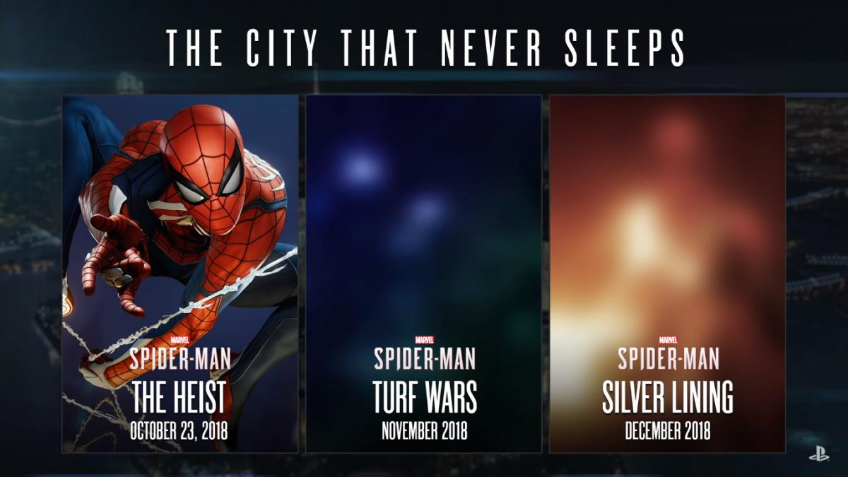
What are the Terminologies in Gaming?
DLC - Downloadable Content - providing additional game content at a later date for additional money.
Eg. Rockstar Games with Grand Theft Auto IV (The Lost and Damned and The Ballad of Tony), or Bethesda with Fallout 3 and its expansions
Expansion Packs - Unlike DLC, expansion packs add a whole section to the game that either already exists in the game's code or is developed after the game is released. Expansions add new maps, missions, weapons, and other things that weren't previously accessible in the original game.
Eg. Bungie's Destiny - Rise of Iron Exp pack (added new weapons, new maps, and higher levels, and remade old missions), Assassin's Creed IV: Black Flag Freedom Cry, which features a different character than the original game
Spiderman PS4 DLCs

Slide 10
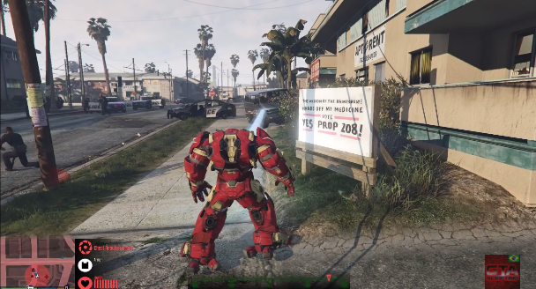
What are the Terminologies in Gaming?
Modifications - technically oriented consumers can modify the game. These mods can add an extra dimension of replayability and interest.
Devs - id Software, Valve Corporation, Crytek, Bethesda, Epic Games and Blizzard Entertainment ship their games with some of the development tools used to make the game, along with documentation to assist mod developers.
Eg. Half-Life mod Counter-Strike
Cheating - Cheating in computer games may involve cheat codes and hidden spots implemented by the game developers, modification of game code by third parties, or players exploiting a software glitch. Cheats usually make the game easier by providing some unfair advantage.
Eg. Cheats in GTA games
Iron Man Mod for GTA V

Slide 11
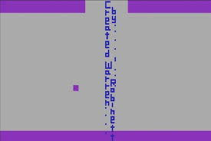
What are the Terminologies in Gaming?
Glitches - Software errors not detected by software testers during development can find their way into released versions of computer and video games. This may happen because the glitch only occurs under unusual circumstances in the game, was deemed too minor to correct, or because the game development was hurried to meet a publication deadline. Glitches can range from minor graphical errors to serious bugs that can delete saved data or cause the game to malfunction.
Publishers release ‘Patches’ to fix such bugs
Glitches useful to the player are called ‘Exploits’
Easter Eggs - Hidden messages or jokes left in games by developers that are not part of the main game
Cheat codes are a special form of easter eggs
First ever Easter egg in the game ‘Adventure’

Slide 12
What are the various Genres of Games?
Action -
Platform - Donkey Kong, Mario Bros.
Shooter -
Hero Shooter - Overwatch, Paladins, Gigantic
MOBA (Multiplayer Online Battle Arena) - Dota 2, League of Legends
Shoot em ups (FPS) - Counter Strike, Wolfenstein 3D, Doom, Half life
Fighting - Super Smash Bros.
Beat em ups - Street Fighter Series
Stealth - Metal Gear series
Survival - Minecraft, Fortnite, Playerunknown's BattleGrounds
Rhythm - Guitar Hero
Action-Adventure - Legend of Zelda (revolutionized 8 bit era gaming)
Survival Horror - Resident Evil Series
Metroidvania - Metroid and Castlevania Series
Adventure -
Text and Graphics - Zork, Mystery House
Visual Novels - Ace Attorney
Interactive Movie - Tex Murphy, Fahrenheit (Indigo Prophecy)
Realtime 3D - Nightfall, Uru: Ages beyond Myst

Slide 13
What are the various Genres of Games?
Role-Playing -
Action RPG - Dragon Slayer Series
MMORPG - Final Fantasy XI, Lord of the Rings Online, Elder Scrolls Online, World of Warcraft
Tactical RPG - Final Fantasy Tactics
Sandbox RPG - Deus Ex, Elder Scrolls, Fallout Series
First-person Party based RPG - Dungeon Master
Choices - Minecraft: Story Mode
Fantasy - Diablo, Baldur’s Gate
Simulation -
Construction and management simulation - SimCity, Caesar Trilogy
Life - SimLife, Spore
Vehicle - Orbiter
Sports -
Racing - Need for Speed Series
Physical sports - FIFA
Competitive - Ball Jacks

Slide 14
What are the various Genres of Games?
Strategy -
4X(eXplore, eXpand, eXploit and eXterminate) - Empire Earth, Civilization
Artillery - Pocket tanks, Worms
Realtime - Warhammer: Dark Omen, World In Conflict
MOBA - Smite, DOTA 2
Tower Defense - Plants vs Zombies
Turn based Strategy - Master of Orion
Turn based Tactics - Wars
Wargame - Commandos

